Slide 1

Microsoft
Financial Statements
Evaluation
By
22071A3258 – Tejasree Lokireddy

Slide 2
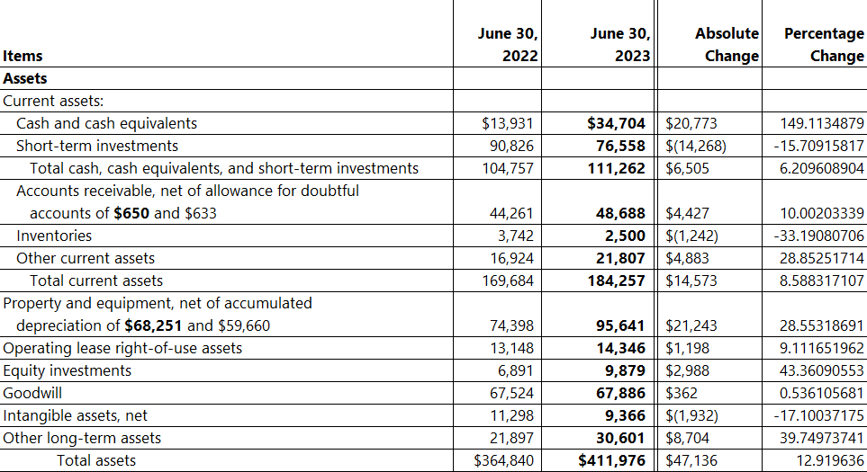
Comparative Balance Sheet
Strong Cash Position: Cash & cash equivalents increased 149%, improving liquidity for operations and investments.
Higher Investment in Infrastructure: Property & equipment grew by 28.5%, indicating expansion in cloud and AI capabilities.

Slide 3
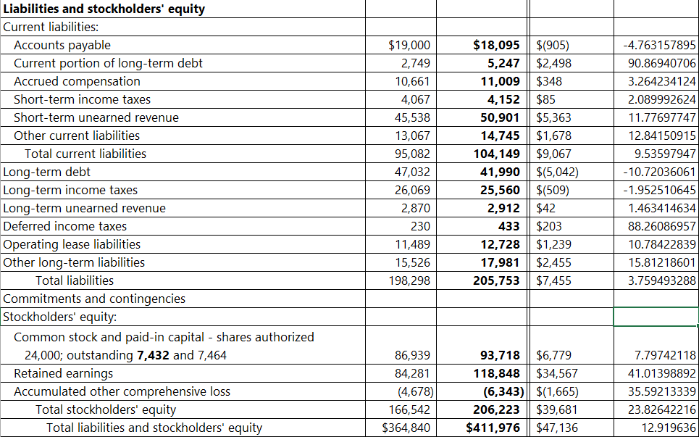
Comparative Balance Sheet
Debt Reduction Strengthens Financial Health: Long-term debt declined by 10.7%, lowering leverage and interest obligations.
Stronger Equity Base: Retained earnings rose by 41%, reflecting high profitability and reinvestment capacity.

Slide 4
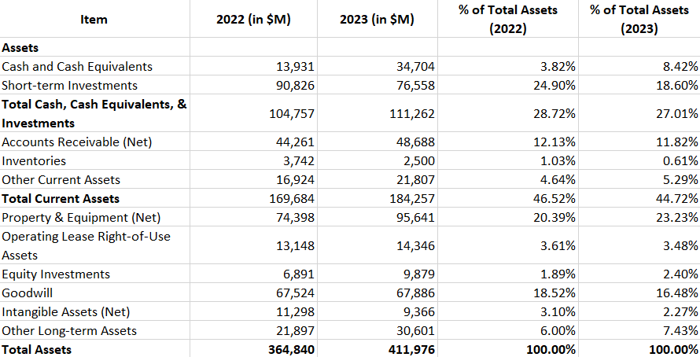
Common Size Balance Sheet
Cash Reserves Nearly Doubled: Cash & cash equivalents grew from 3.82% to 8.42% of total assets, improving short-term liquidity.
Reduced Short-term Investments: Short-term investments dropped from 24.9% to 18.6%, indicating a shift toward liquid assets.

Slide 5
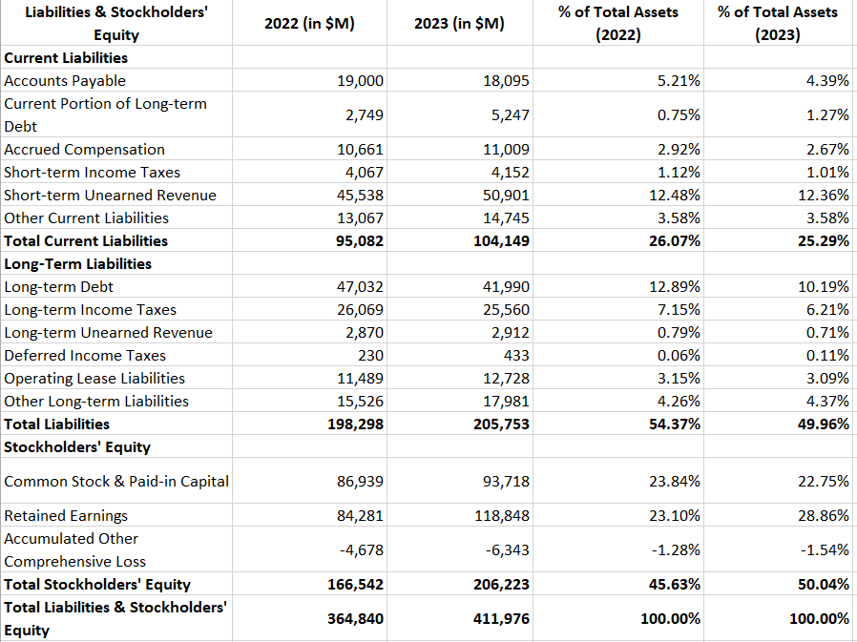
Common Size Balance Sheet
Lower Debt Proportion: Long-term debt declined from 12.89% to 10.19%, reducing financial risk.
Higher Equity Contribution: Stockholders' equity rose from 45.63% to 50.04%, reflecting stronger financial stability.

Slide 6
Trend Analysis –
Total Assets vs. Total Liabilities vs. Equity
Total Assets Up by 12.92% – Business expansion and higher infrastructure investment.
Total Liabilities Up by 3.76% – Increase in short-term obligations, but reduced long-term debt.
Equity Up by 23.83% – Higher retained earnings and reinvestment for growth.

Slide 7
Trend Analysis –
Debt reduction and Increased Earnings
Long-term debt reduced by 10.7%, signaling lower financial risk.
41% increase in retained earnings, highlighting strong profitability.

Slide 8
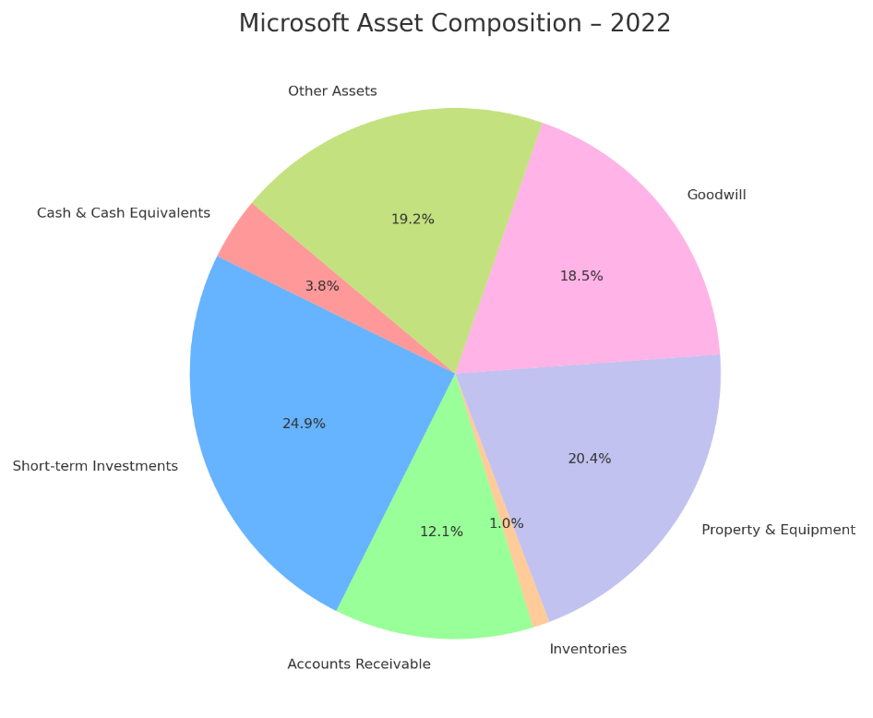

Trend Analysis –
Asset Composition
Increased Cash Reserves – More liquidity for strategic flexibility.
Lower Short-term Investments – Shift towards cash holdings and long-term growth.
Higher Investment in Property & Equipment – Strong focus on AI & cloud expansion.
Reduced Goodwill & Inventory – Indicating streamlined operations & fewer acquisitions.

Slide 9
THANK YOU

